Slide 1
Financial Aid 101
Funding a College Education

Slide 2
Cost of Attendance
Direct Costs
Tuition
Room & Board
Fees
Indirect Costs
Books
Travel
Personal

Slide 3
Cost of Attendance
 | 2-yr Public | 4-yr Public | TN Private; Out of State
Tuition/Fees | $3,671 | $9,092 | $41,088
Room/Board |  | $8,752 | $13,818
 | 2-yr Public | 4-yr Public | TN Private; Out of State
Tuition/Fees | $3,671 | $9,092 | $41,088
Room/Board | $3,012 | $8,752 | $13,818
Books/Supplies | $900 | $1,492 | $1,370
Transportation | $2,837 | $1,638 | VARIES
Miscellaneous | $500 | $3,772 | $4,320
COA | $10,920 | $24,746 | $60,596

Slide 4
Financial Aid Terms
COA – cost of attendance; varies by institution
EFC – expected family contribution; number derived from the FAFSA and used to determine need based aid eligibility
FAFSA – Free Application for Federal Student Aid
PIN – personal identification number; used to electronically sign the FAFSA
SAR – student aid report; summary of FAFSA information
Grant – free money based on need
Loan – money borrowed that must be paid back with interest
Scholarship – free money awarded on the basis of merit, skill, or unique characteristic
Verification – random “audit” of FAFSA
Work study – money received from on campus employment

Slide 5
Financial Aid Sources
Package
Federal
State
Private
Institutional

Slide 6
Institutional Aid
Academic
Competitive?
Renewable?
Deadlines
Need-Based
Determined by the EFC
College may use “Institutional Methodology”
Performance
Art
Athletic
Major
Music
Theatre
Attribute
Church affiliation
Alumni
Diversity
Sibling

Slide 7
ACT
ACT TEST DATE | REGISTRATION DEADLINE | LATE FEE DEADLINE
September 21, 2013 | August 23, 2013 | September 6, 2013
October 26, 2013 | September 27, 2013 | October 11, 2013
December 14, 2013 | November 8, 2013 | November 22, 2013
February 8, 2014 | January 10, 2014 | January 24, 2014
March 4, 2014 | **JUNIORS** SEE SCHOOL COUNSELOR
April 12, 2014 | March 7, 2014 | March 21, 2014
June 14, 2014 | May 9, 2014 | May 23, 2014

Slide 8
SAT
SAT TEST DATE | REGISTRATION DEADLINE | LATE FEE DEADLINE
October 5, 2013 | September 6, 2013 | September 20, 2013
November 2, 2013 | October 3, 2013 | October 18, 2013
December 7, 2013 | November 8, 2013 | November 22, 2013
January 25, 2014 | December 27, 2013 | January 10, 2014
March 8, 2014 | February 7, 2014 | February 21, 2014
May 3, 2014 | April 4, 2014 | April 18, 2014
June 7, 2014 | May 9, 2014 | May 23, 2014

Slide 9
Private Aid
www.fastweb.com
www.collegefortn.org
School counselor
Other high school websites

Slide 10
FAFSA
2014-15 FAFSA on the Web
Available January 1, 2014
www.fafsa.gov (VERY IMPORTANT!)
Priority deadline is as soon as possible after January 1, 2014!

Slide 11
FAFSA
Pell
FSEOG
Work Study
$582 - $5,645
0 – 5081 EFC Need based
$100 - $4,000
Amount Varies
Typically paid to student
Exceptional financial need

Slide 12
FAFSA
Subsidized Stafford
Unsubsidized Stafford
Parent PLUS
6.8% fixed
Interest does not accrue
6.8% fixed
Interest does accrue
7.9% fixed
Interest does accrue

Slide 13
Loan Wisdom
Borrow Federal first because they’re cheaper, more available, and have better repayment terms than private student loans.
Live like a student while you’re in college so you don’t have to live like one after college.
Do not borrow more for your entire education than your expected starting salary after you graduate.
If you are borrowing more than $10,000/year for college, consider a less expensive school.

Slide 14
FAFSA
Hope Scholarship
GAMS
Aspire Award
Parents AGI <=$36,000
$750 per semester
29 ACT or 1280 SAT & 3.75 GPA
$500 per semester
$1,000 or $2,000 per semester
21 ACT or 980 SAT or 3.0 GPA

Slide 15
FAFSA
TSAA
$1,000 – $4,000
0 EFC FAFSA January
Hope Access
$875 or $1,375 per semester
18 ACT & 2.75 GPA & Parents AGI <=$36,000
Wilder- Naifeh
$2,000
Certificate/ Diploma TTC

Slide 16
Online Applications
Ned McWherter
Dependent Children
See brochure
Award amount varies
Up to $6,000 February 15
29 ACT & 3.5 GPA
Dual Enrollment Grant
Contact institution
High school juniors/seniors

Slide 17
Other Aid
Academic Common Market
Fee Discount Program
CSS Profile

Slide 18
Award Letter
0 EFC; 3.0 GPA | 2-yr Public | 4-yr Public | TN Private
COA | $10,920 | $24,746 | $60,596
Pell Grant | -$5,645 | -$5,645 | -$5,645
HOPE/Aspire | -$3,500 | -$5,500 | -$5,500
Institutional | ??? | ??? | ???
Private | ??? | ??? | ???
Net Price | $1,775 | $13,601 | $49,451
0 EFC; 3.0 GPA | 2-yr Public | 4-yr Public | TN Private
COA | $10,920 | $24,746 | $60,596
Pell Grant | -$5,645 | -$5,645 | -$5,645
HOPE/Aspire | -$3,500 | -$5,500 | -$5,500
Institutional | ??? | ??? | ???
Private | ??? | ??? | ???

Slide 19
Award Letter
5082 EFC; 3.0 GPA | 2-yr Public | 4-yr Public | TN Private
COA | $10,920 | $24,746 | $60,596
Pell Grant | $0 | $0 | $0
HOPE | -$2,000 | -$4,000 | -$4,000
Institutional | ??? | ??? | ???
Private | ??? | ??? | ???
Net Price | $8,920 | $20,746 | $56,596
5082 EFC; 3.0 GPA | 2-yr Public | 4-yr Public | TN Private
COST | $10,920 | $24,746 | $60,596
Pell Grant | $0 | $0 | $0
HOPE | -$2,000 | -$4,000 | -$4,000
Institutional | ??? | ??? | ???
Private | ??? | ??? | ???

Slide 21
Senior Year Checklist
Fall Semester
Take and retake the ACT/SAT
Apply to several colleges (admissions, institutional aid, etc) and utilize their net price calculators
Complete local/private scholarship applications
Spring Semester
Complete 2014-15 FAFSA available January 1, 2014
Continue completing local/private scholarship applications
Review college acceptances, compare financial aid packages, ask questions, and follow up as needed

Slide 22
Social Media
Like us on Facebook at: Tennessee Student Assistance Corporation Follow us on Twitter: @TNFinancialAid Check out our website at: www.TN.gov/collegepays

Slide 23
Contact Info
Jason.Seay@TN.gov
615.253.7459 (o)
615.319.1740 (c)

Slide 24
FAFSA
2012-13 FAFSA on the Web
Available now
www.fafsa.gov (VERY IMPORTANT!)
Priority deadline is as soon as possible after January 1, 2012!

Slide 25
Student Demographics
Last Name, First Name, SSN – must match social security card
Length of residency question
E-mail – leave blank if you prefer to receive information by postal mail
Selective Service – males only; register me
Grade level – never attended college/1st yr.
Degree – 1st bachelor’s degree, associate degree, certificate or diploma
Work-study – yes

Slide 26
School Selection
Carson Newman – 003481
ETSU – 003487
Maryville College – 003505
Pellissippi State – 012693
Tusculum – 003527
UT Knoxville – 003530
Walters State – 008863

Slide 27
School Selection
Belmont University – 003479
Chattanooga State – 003998
Columbia State – 003483
MTSU – 003510
Motlow State – 006836
Tennessee Tech – 003523
UT Chattanooga – 003529

Slide 28
School Selection
Bethel University – 003480
Christian Brothers – 003482
Freed-Hardeman – 003492
Jackson State CC – 004937
Southwest CC – 010439
University of Memphis – 003509
UT Martin– 003531

Slide 29
Dependency Status
If all “no” responses, student is dependent; parental information needed
If “yes” to any question, student is independent; parental information is not needed
If you have a special circumstance and cannot provide parental information, contact the financial aid office at the college(s) you plan to attend in order to complete the FAFSA; professional judgment

Slide 30
Parent Demographics
Parent – adoptive or biological
Divorced/separated – answer questions about parent whom you lived with more during the past 12 months
Remarried – answer questions about parent you live with and your stepparent
Last Name, 1st initial of 1st name, SSN – must match social security card
Length of residency question
# in college – do not include your parents in this number

Slide 31
Financial Information
2013 IRS tax return – already completed, will file, or not going to file
Will file – 2012 tax return, 2013 W-2 forms, or last pay stub
Income tax – amount paid; should not be the same as the AGI
IRS Data Retrieval Tool – once 2013 tax return is completed, return to FAFSA to make corrections; tax information imported directly from IRS; simplifies verification

Slide 32
Sign & Submit
Preparer – no
Sign electronically – student and parent must each create PIN; may be identical
I Forgot/Don’t Know My PIN – challenge question (what city were you born in); case sensitive
Terms of Agreement – agree
SUBMIT MY FAFSA NOW – see I promised it wasn’t that bad!

Slide 33
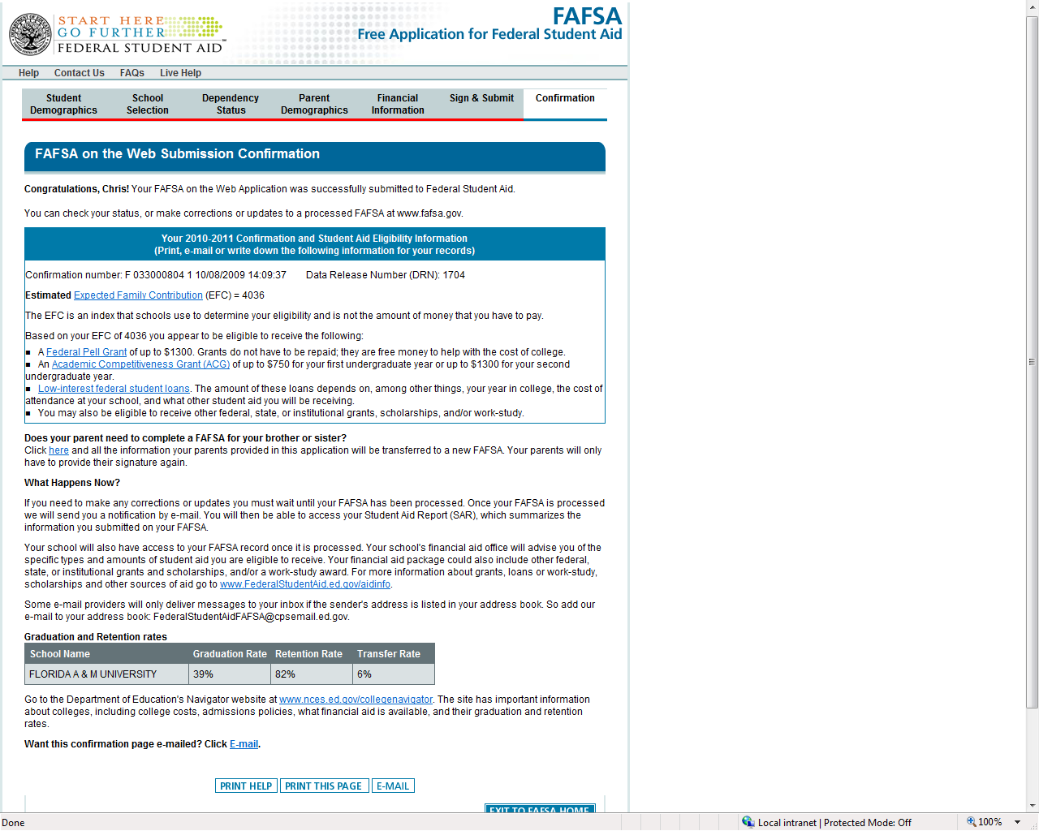
Confirmation
Pell Grant estimate (0 – 5081 EFC) and info on student loan eligibility
Detailed college information (grad, retention, and transfer rates)
Begin a new application with parents’ info link

Slide 34
Student Aid Report
Notification of FAFSA processing results via e-mail (if provided on FAFSA) or paper (if e-mail not provided on FAFSA) or online
Review data for accuracy
Institutional Student Information Report (ISIR) sent to colleges listed on FAFSA two weeks after initial FAFSA submission
Additional documentation may be requested by institution; verification

Slide 35
HOPE Renewal
24 attempted hour benchmark
72 attempted hour benchmark
2.75 – 2.99 cumulative GPA & 3.0 semester GPA
3.0 cumulative GPA or
2.75 cumulative GPA
48 attempted hour benchmark
2.75 cumulative GPA
96 attempted hour benchmark
3.0 cumulative GPA or
2.75 – 2.99 cumulative GPA & 3.0 semester GPA

